Slide 1
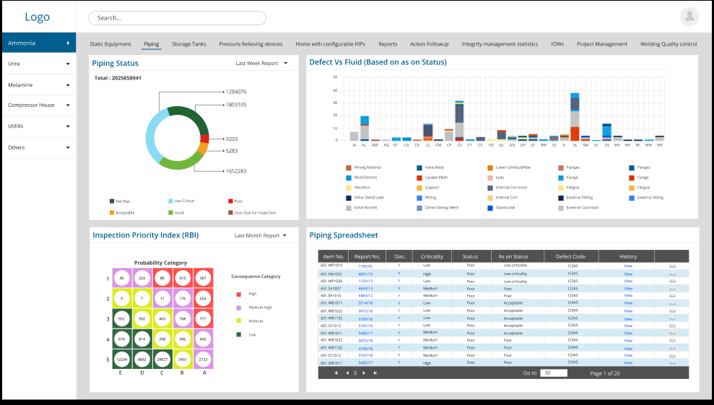
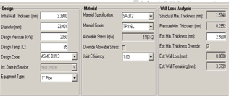
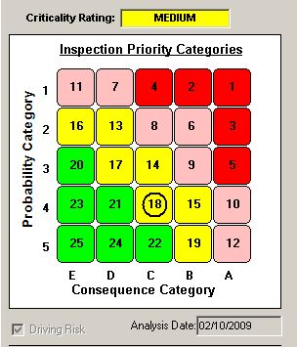
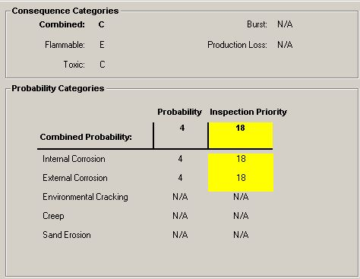
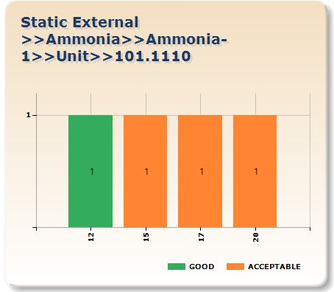
1st tab – Basic Data (default Tab)
Line No |  | Loop No |  | Status
Description |  | Cluster No |  | Next Insp
From To |  | Year Service |  | Next Followup
P&ID No |  | Fluid
Plant |  | Material Code
Area |  | Train
DM | DM descriptio | Priority | Frequency | Recommended Program
IC | Internal | 18 | 10 | TM at all elbows and RT on tappings
EC/CUI | CUI | 14 | 10 | 100% visual, 20% RT for CUI
SCC | CL_SCC | 8 | 5 | PT test on 10% welds
OT1 | CREEP | 8 | 5 | Metallography at 3 locations
OT2 | BELLOW | 14 | 10 | 100% PT test
Reports
Piping
POF
COF
TML
When a line number is selected the charts will change to as shown above.
Chart-1 (bottom right) will show the priority matrix of all the damage mechanisms for that line based on POF and COF.
Chart-2 (bottom left) will show the damage mechanism and proposed inspection program with priority.
Chart-3 (top right) shows the bar chart showing previous inspections. By clicking on the bar chart the report opens.
Chart-4 (top left)shows design and operating data of the line.
Then we have tabs on bottom which will have different pages showing the relevant data for that line from Pipe master table and parameters for POF and COF calculation

Slide 2
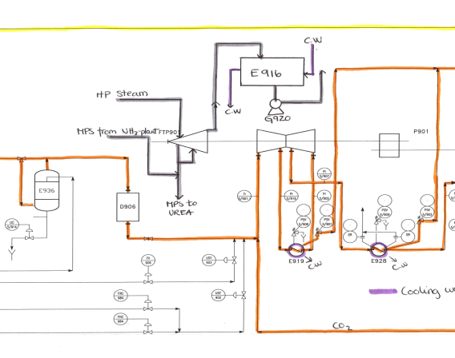
2nd Tab – Design Data
Design Temp |  | Material Std |  | Insulated
Design Pressure |  | Material Grade |  | Insulation Type
Operating Temp |  | Material Code |  | Nom Dia
Operating Pressure |  | PWHT |  | Nom Thk
Pipe Spec |  | Corrosion allowance |  | Length
Joint Efficiency |  |  |  | MDMT Temp
Construction Code
Reports Menu
Piping
POF
COF
TML
Document No | description | format
01-001 | iSometric-1 | pdf
101.1101 | Summary report | word
101.1102 | history | word
101.1103 | photoraphs | jpeg
When a line number “design data “ (2nd tab not shown above) tab is selected the charts will change to as shown above.
Left side will show a form with all relevant design data of this line.
Chart-1 (Right top) will shows the drawing view. Double clicking this will open the drawing (pdf, autocad etc)
Chart-2 (Right Bottom) shows the drawings list by selecting which the drawing will display on right top chart.

Slide 3
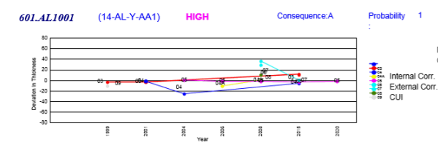
3rd Tab – Internal Corrosion
Design Temp |  | Material Std |  | Insulated
Design Pressure |  | Material Grade |  | Insulation Type
Operating Temp |  | Material Code |  | Nom Dia
Operating Pressure |  | PWHT |  | Nom Thk
Pipe Spec |  | Corrosion allowance |  | Length
Joint Efficiency |  |  |  | MDMT Temp
Construction Code
Reports Menu
Piping
POF
COF
TML
ML no | Nom Thk | Dia | Min req t | Last Mea | Long T CR | Short Te | Half Li | Next I
01 | 5.6 | 6 | 3 | 4.5 | 0.15 | 0.1 | 5 | 2025
02 | 6 | 8 | 4 | 5 | 0.1 | 0.1 | 5 | 2025
03 | 7.2 | 10 | 5 | 6.5 | 0.25 | 0.2 | 10 | 2030
When a line number Internal corrosion tab is selected the charts will change to as shown above.
Left top : will show a form with all relevant data required for internal corrosion POF calculation.
Left bottom: will shows the TML trending from TML table (internal corrosion).
Right Bottom: shows the list of TML locations if any with relevent data as explained in below slides
Right top: Will show the drawings (may be more than one) indicating the TML locations on the drawing

Slide 4
4th Tab – External Corrosion
Soil Interface/Condensation | N | Theoritical Ex corrosion rate |  | Inspection confidence
Pipe direct on beam/ complex design |  | Measured long term CR |  | Very High
Coating Quality- CQ(H/M/L) |  | Measured Short term CR |  | High
EC driver (climate) M/T/D/S |  | Last measured Thk |  | Med
Coating age (COATAGE) |  | Last measured Year |  | Low
Coat Adjustment |  | Effective CR |  | Damage Factor
Pr Min Req Thk |  | Repainted Year |  | POF
Reports Menu
Piping
POF
COF
TML
ML no | Nom Thk | Dia | Min req t | Last Mea | Long T CR | Short Te | Half Li | Next I
01 | 5.6 | 6 | 3 | 4.5 | 0.15 | 0.1 | 5 | 2025
02 | 6 | 8 | 4 | 5 | 0.1 | 0.1 | 5 | 2025
03 | 7.2 | 10 | 5 | 6.5 | 0.25 | 0.2 | 10 | 2030
When a line number External corrosion tab is selected the charts will change to as shown above.
Left top : will show a form with all relevant data r equired for external corrosion POF calculation.
Left bottom: will shows the TML trending from TML table external corrosion).
Right Bottom: shows the list of TML locations if any with relevent data as explained in below slides
Right top: Will show the drawings (may be more than one) indicating the TML locations on the drawing

Slide 5
5th Tab – Environment Cracking
DM Code | Initial Sucep | Severity Index | Found | VH | H | M | L | Last Insp Year VH | Reduction Fac | Damage Factor | POF | DM name
Reports Menu
Piping
POF
COF
TML
ML no | Nom Thk | Dia | Min req t | Last Mea | Long T CR | Short Te | Half Li | Next I
01 | 5.6 | 6 | 3 | 4.5 | 0.15 | 0.1 | 5 | 2025
02 | 6 | 8 | 4 | 5 | 0.1 | 0.1 | 5 | 2025
03 | 7.2 | 10 | 5 | 6.5 | 0.25 | 0.2 | 10 | 2030
When a line number Environmental cracking tab is selected the charts will change to as shown above.
Top : will show a form with all relevant data required for SCC POF calculations of all relevant SCC DMs.
Right Bottom: shows the bar charts showing previous inspection confidence levels for this DM – for the DM row that is selected in above table
Left Bottom: Will show the drawings (may be more than one) indicating the CML locations on the drawing

Slide 6
6th Tab – Consequence
Applicable Fluid as per Table 4.1 |  | Fluid |  | Mass of Inventory Fluid Minv |  | Length of Component, l mm
Normal Boiling Point ⁰C |  | Operating Temperature Ts K |  | Detection System Rating |  | Mass of Fluid in component Mcomp
Molecular Weight |  | Operating Pressure Ps KPa |  | Fluid Phase at released condition |  | Inner diameter of Component, d mm
Fluid Phase stored |  | Component Type
Reports Menu
Piping
POF
COF
TML
When a line number Environmental cracking tab is selected the charts will change to as shown above.
Left : will show a form with all relevant data required for SCC POF calculation.
Right Bottom: shows the bar charts showing previous inspection confidence levels for this DM
Right top: Will show the drawings (may be more than one) indicating the CML locations on the drawing

Slide 7
7th Tab – Other DMs
DM Code | Initial Sucep | Severity Index | Found | VH | H | M | L | Last Insp Year VH | Reduction Fac | Damage Factor | POF | DM name
Reports Menu
Piping
POF
COF
TML
ML no | Nom Thk | Dia | Min req t | Last Mea | Long T CR | Short Te | Half Li | Next I
01 | 5.6 | 6 | 3 | 4.5 | 0.15 | 0.1 | 5 | 2025
02 | 6 | 8 | 4 | 5 | 0.1 | 0.1 | 5 | 2025
03 | 7.2 | 10 | 5 | 6.5 | 0.25 | 0.2 | 10 | 2030
When a line number Other DMs tab is selected the charts will change to as shown above.
Top : will show a form with all relevant data required for SCC POF calculations of all relevant SCC DMs.
Right Bottom: shows the bar charts showing previous inspection confidence levels for this DM – for the DM row that is selected in above table
Left Bottom: Will show the drawings (may be more than one) indicating the CML locations on the drawing

